Slide 1
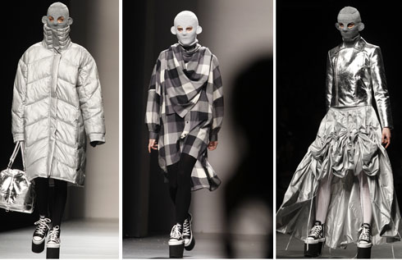
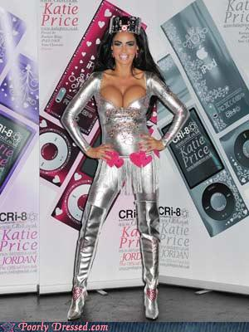
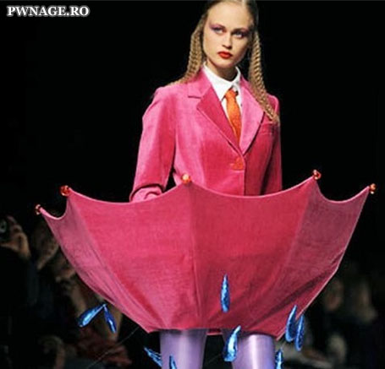
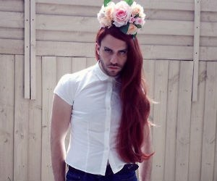
Fashion Careers
By; LESLIE RENTERIA
4th period C;

Slide 2
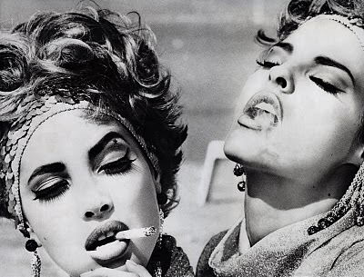
Job 1; Fashion Buyer
Education –When applying for some fashion buyer jobs, some may require fashion or business degrees.
Experience –Having some retail experience in a fashion boutique can also let you make better decisions when you become a buyer
Job description – A fashion buyer is responsible for the products that the company sells, making fashion buyer jobs quite important for the company and for the brand that they carry. They oversee the development of clothes which are targeted towards a particular market and price range.
Locations – online fashion schools ; http://aff.vantageoffers.com/?kid=HLB0&pub_id=2359&cam_id=L115&sub_id_1=XFS&sub_id_2=FashionSchools.htm&amp;a_aid=2359&amp;a_bid=L115L1
Salary – $72,000 – of average fashion buyer
Which segment of the fashion industry- ortertiary
Other info – c;

Slide 3
Job 2; Fashion Editor
Education – bachelor of arts degrees in journalism, fashion design or merchandising.
Experience – internships at fashion publications
Job description – A fashion editor is in charge of guiding the direction of a publication in terms of clothing, accessories and shoes
Locations – U.S. Bureau of Labor Statistics recorded the highest concentration of editing jobs in New York
Salary – average salary is $78,880.
Which segment of the fashion industry- secondary
Other info - c;

Slide 4
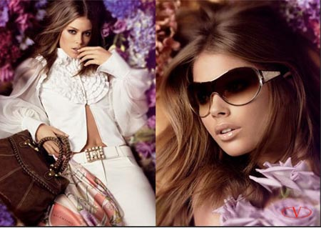
Job 3; Fashion Merchandiser
Education – A 4-year bachelor's degree in Fashion Design & Merchandising or Journalism is required.
Experience –Minimum 1-2 years fashion editorial experience
Job description – Fashion merchandisers may work for a fashion buyer, distributor, manufacturer or retailer.
Locations – New York,NY
Salary – Salary Range: $30,000 to $100,000+
Entry level pay may range from $30,000 to $40,000
Experienced may range from $40,000 to $60,000
Top level pay may range from $70,000 to $100,000
Which segment of the fashion industry- ortertiary
Other info – c;

Slide 5
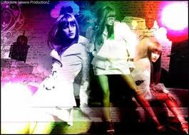
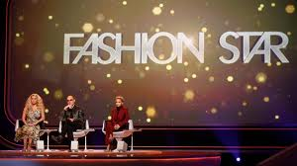
Job 4; Fashion Writer
Education – Given the competition for fashion writing jobs, a college degree in Fashion Journalism or Fashion Merchandising is highly recommended. Coursework or combined working and educational exposure in both fields is especially coveted by prospective employers
Experience – As with any writing job, previous experience - demonstrated by a portfolio or collection of written work - is highly valued.
Job description – Fashion writers produce editorial copy for media outlets such as fashion magazines, newspapers, fashion / design websites or blogs, and of course for television.
Locations – vary
Salary – $68,000+ Median pay potential: $47,000
Which segment of the fashion industry- ortetiary
Other info -

Slide 6
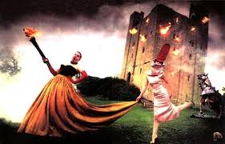
Job 5; PRODUCT DEVELOPER
Education – A 4 year degree, preferably in Merchandizing, textile or business
Experience –preferably in PD or related fields
Job description – This Product Developer will execute and initiate the Product Development of products for a specific buying department.
Locations – factories
Salary – n/a
Which segment of the fashion industry- secondary
Other info – c;

Slide 7
Vocab page ;
words ;

Slide 8
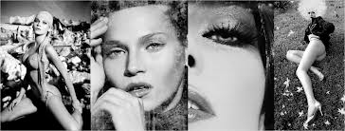
Summary
Trends I noticed ; 4 years bachelor’s degree's in college. All require past work experience in some sort of fashion. Ability to work with others.
Things that surprised me ; having to have a college degree at all.

